Slide 1

Internet of Things
Derek Badman
Pat Maynard
Linda George
Noor Pola

Slide 2
Introduction

Slide 3
What is IoT?!

Slide 4
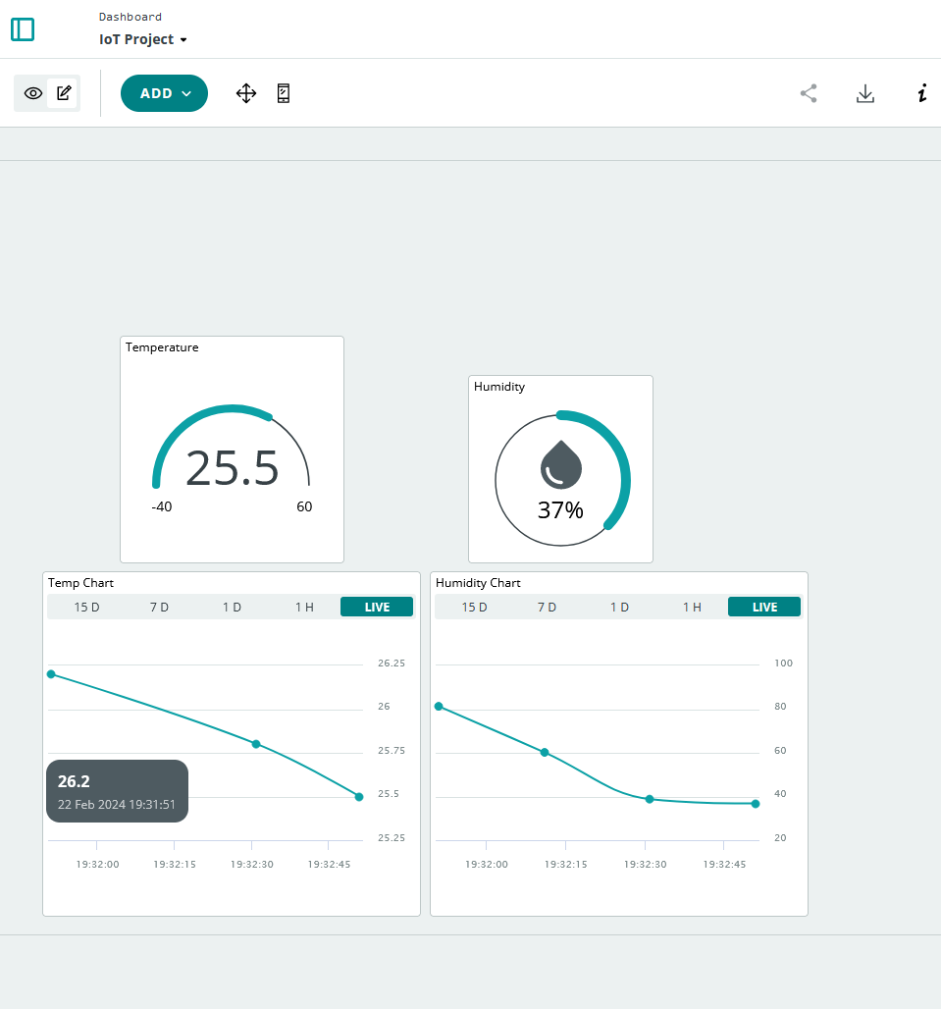
Our Experiment!
We set out to make a simple IoT cloud-based temperature and humidity monitoring system.

Slide 5
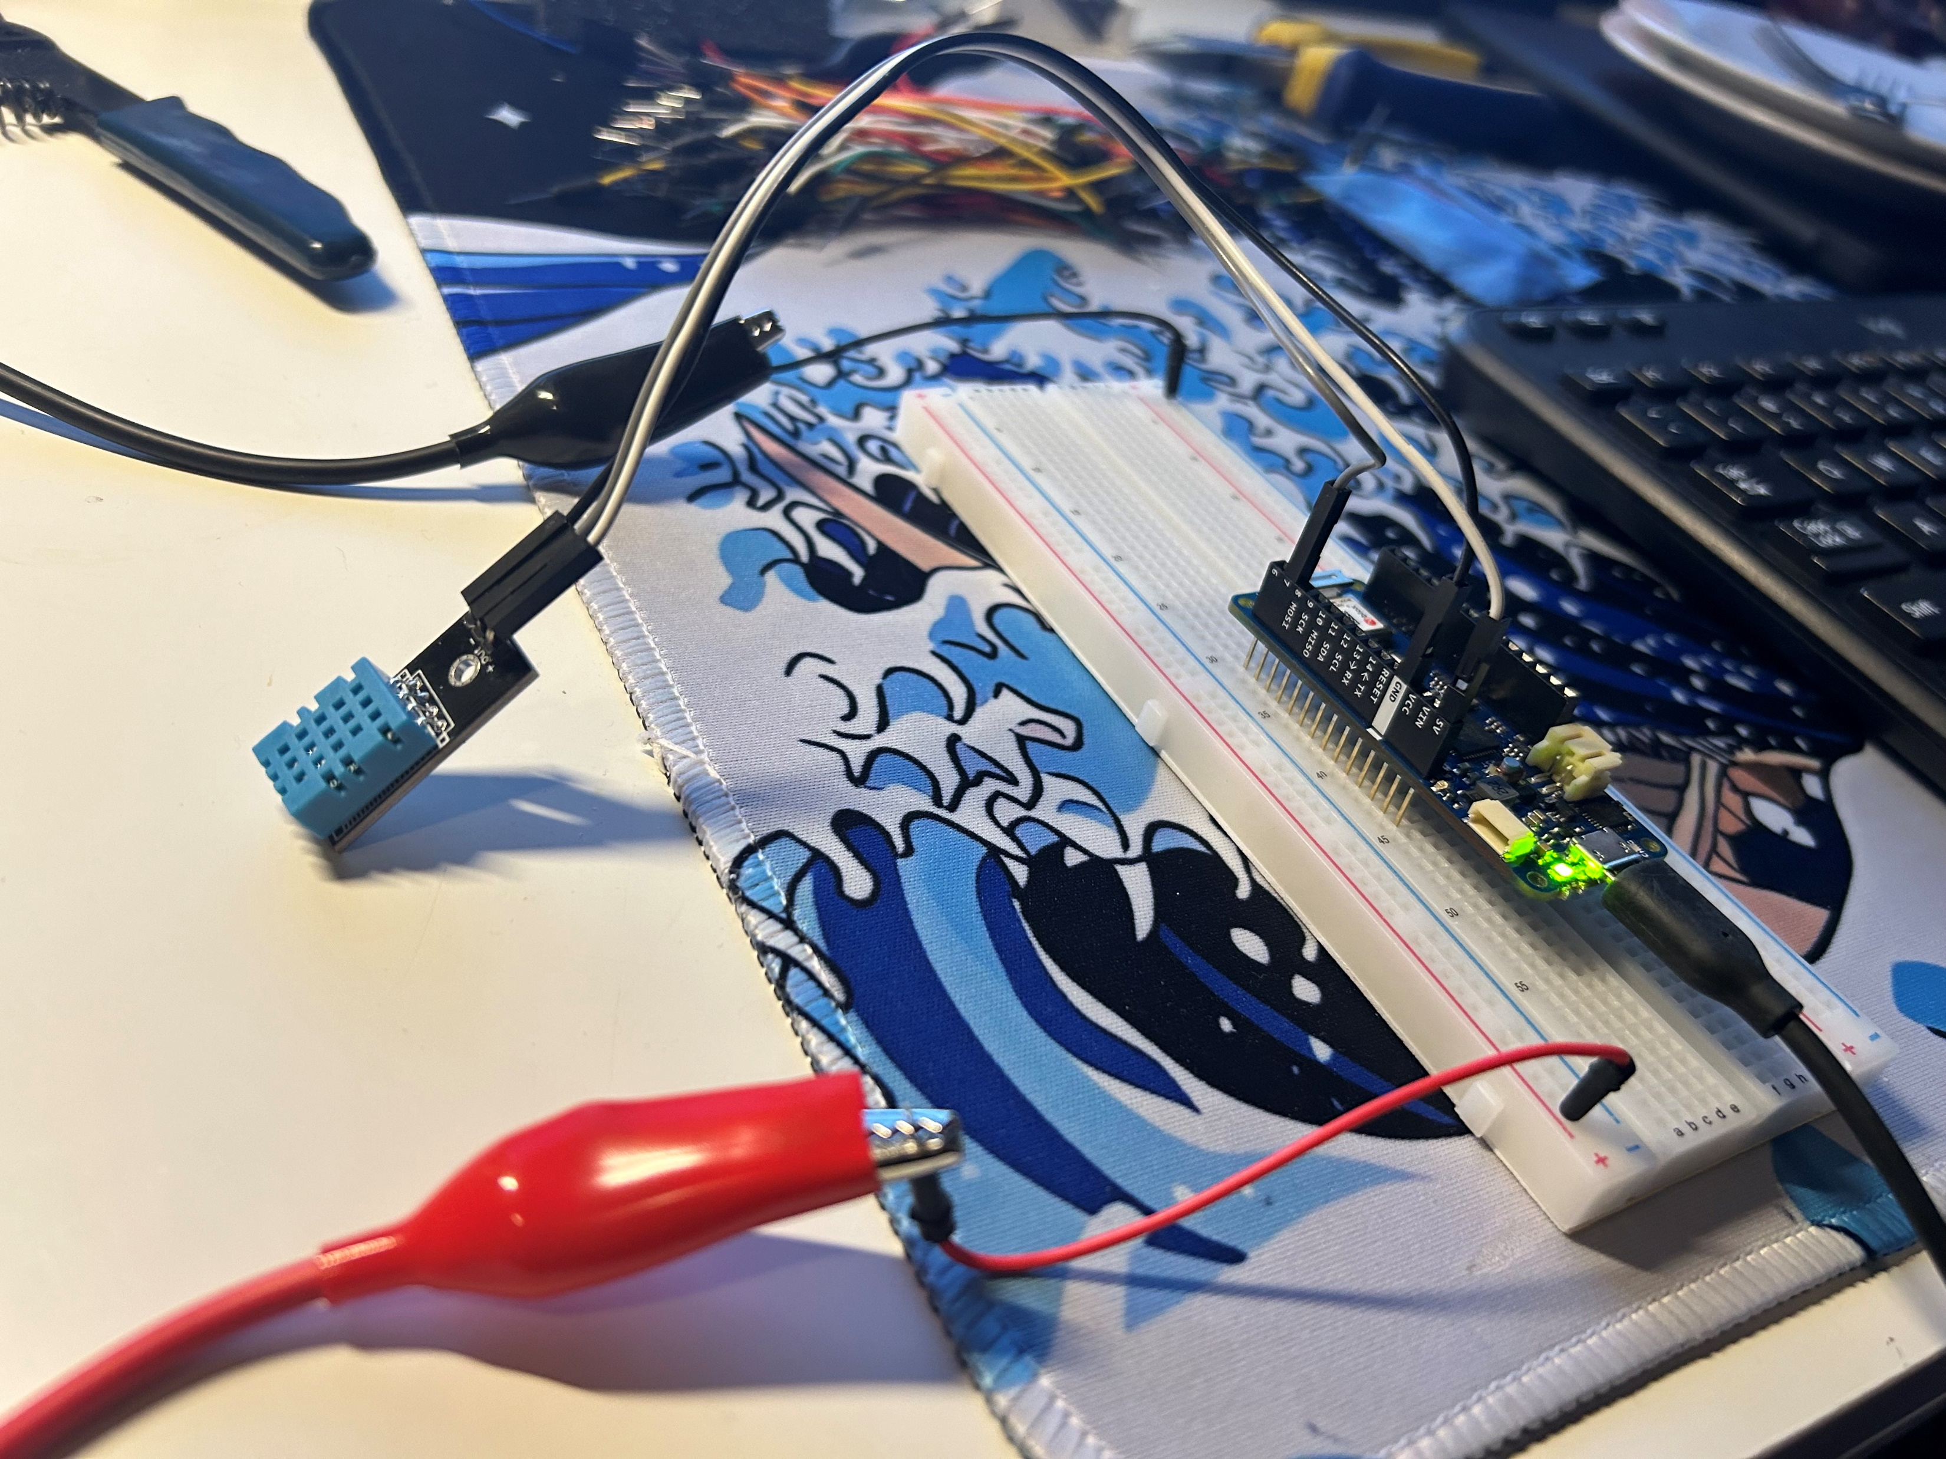
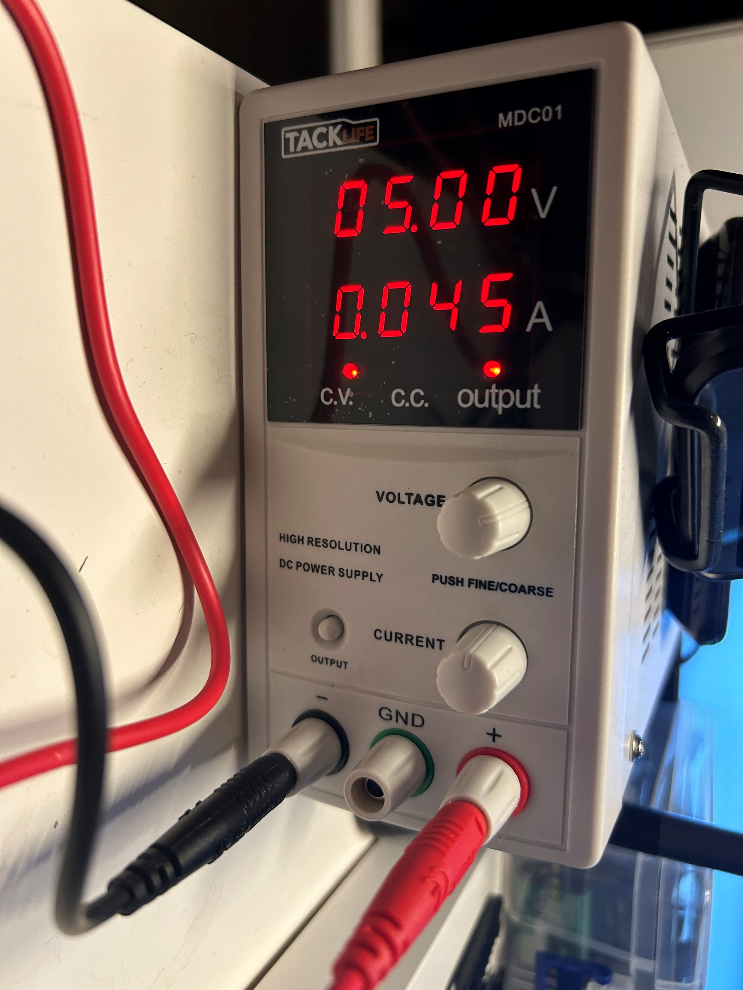
Physical Set-up
We connected an Arduino MKR 1010 wi-fi-enabled board to a DHT multi-function sensor and a power supply to send the signal to our cloud.

Slide 6
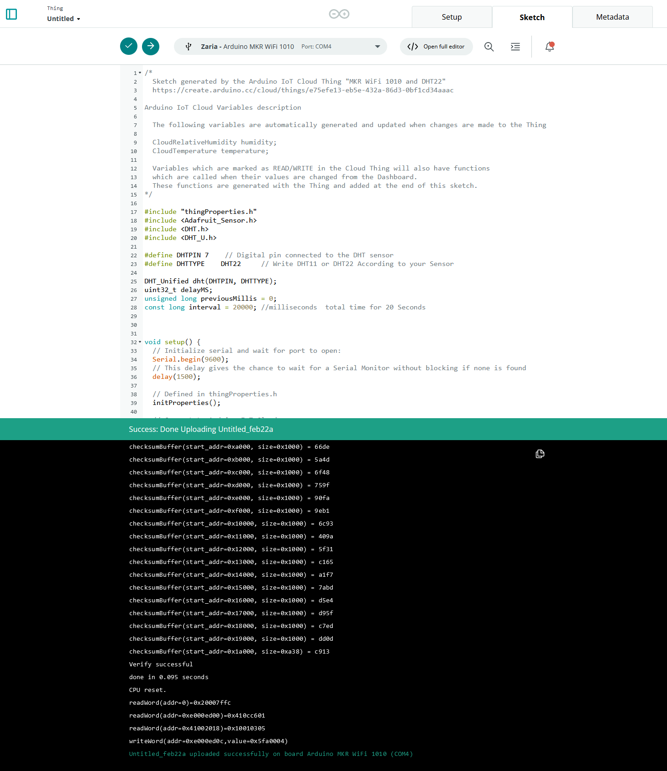
Code
Adding boilerplate code to the board for base functionality was the next step.
We used the browser-based IDE provided by Arduino Cloud.

Slide 7
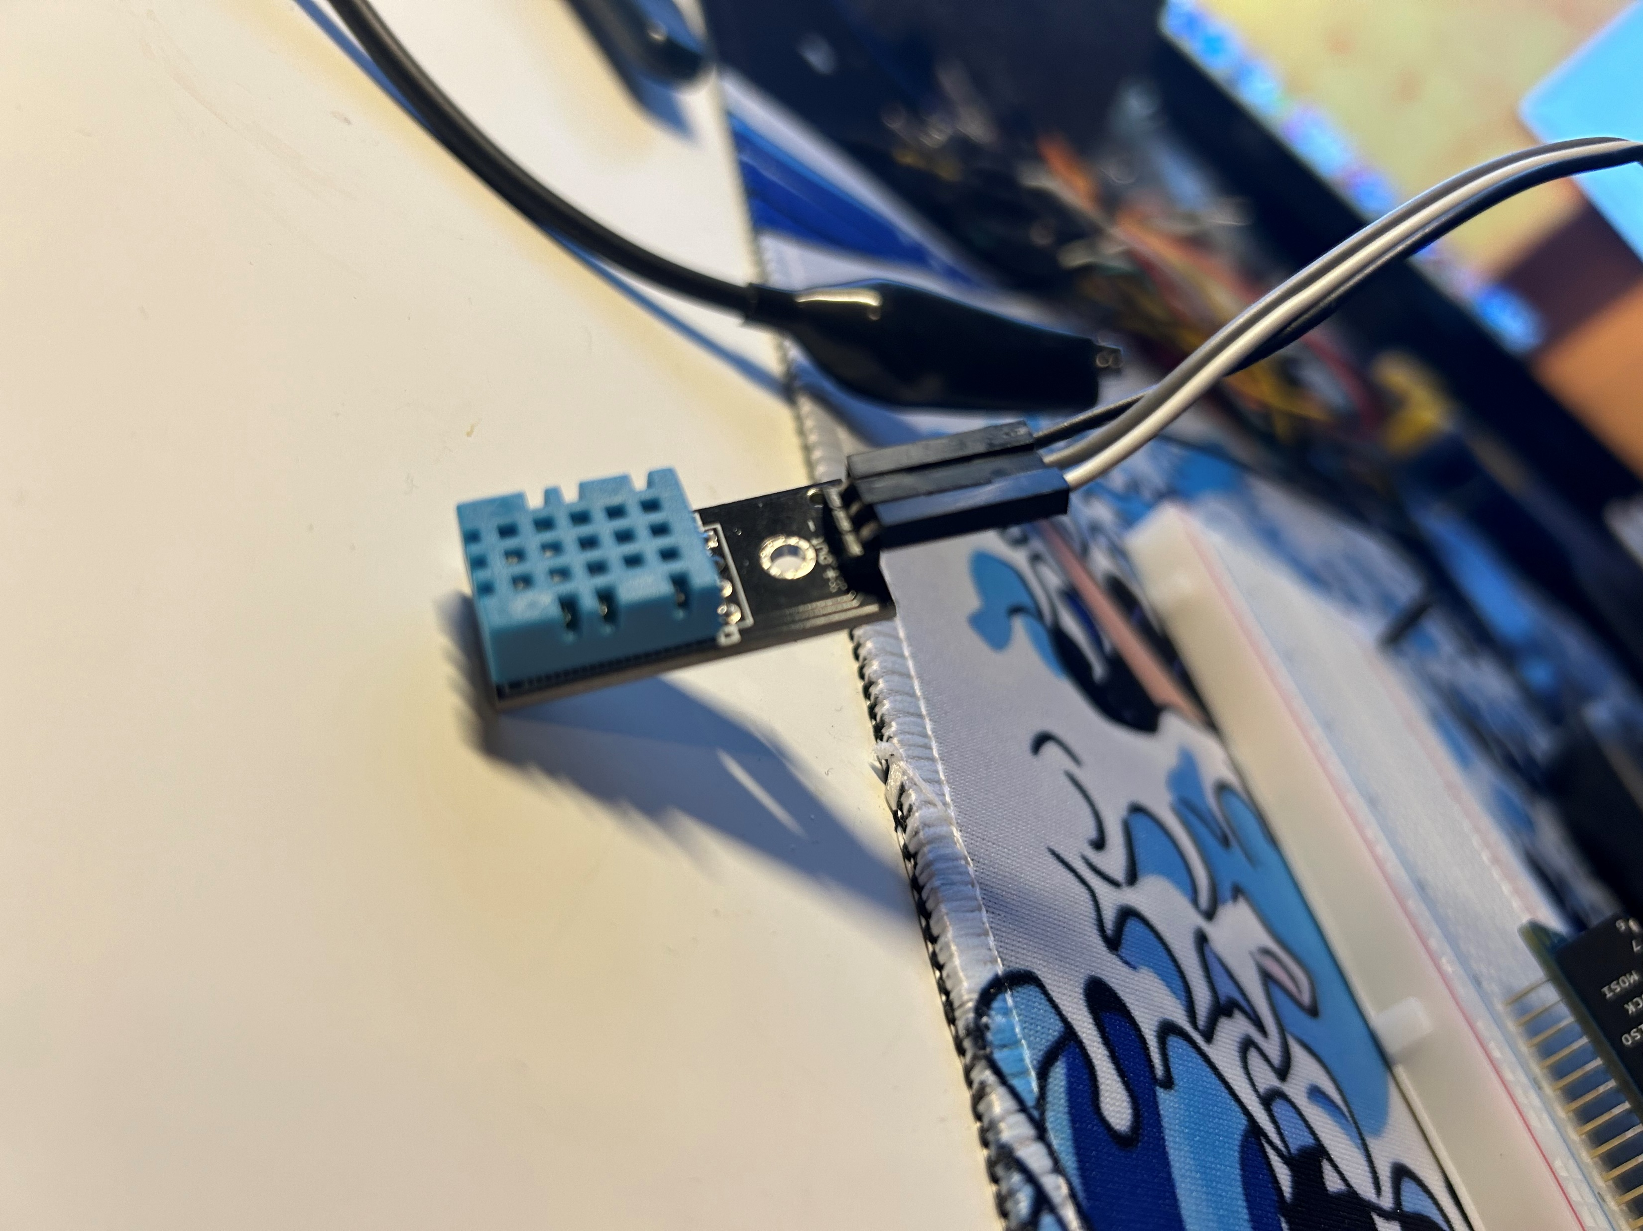
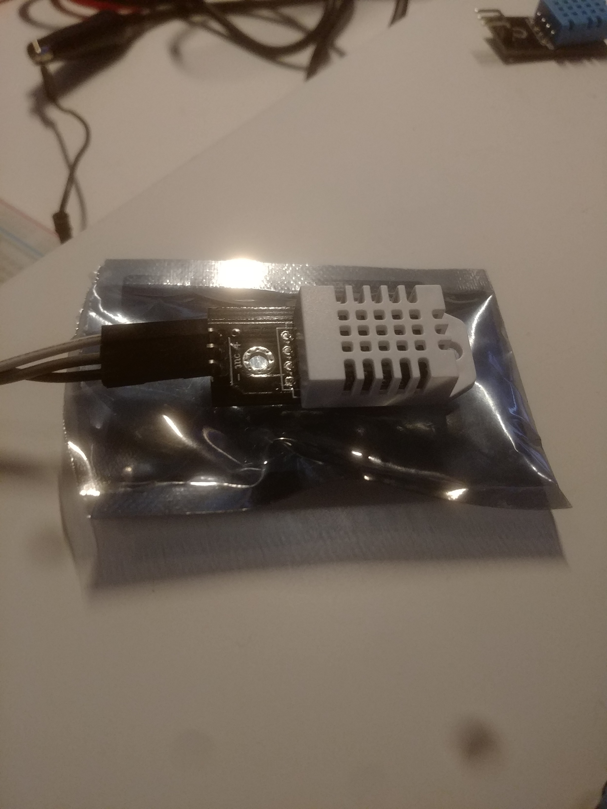
Troubleshooting
We had VERY high outputs initially. This raised a red flag that something was wrong with our setup.
After some analysis, replacing our sensor was necessary.
Switched from a DHT11 (Blue) to a DHT22 (White)

Slide 8
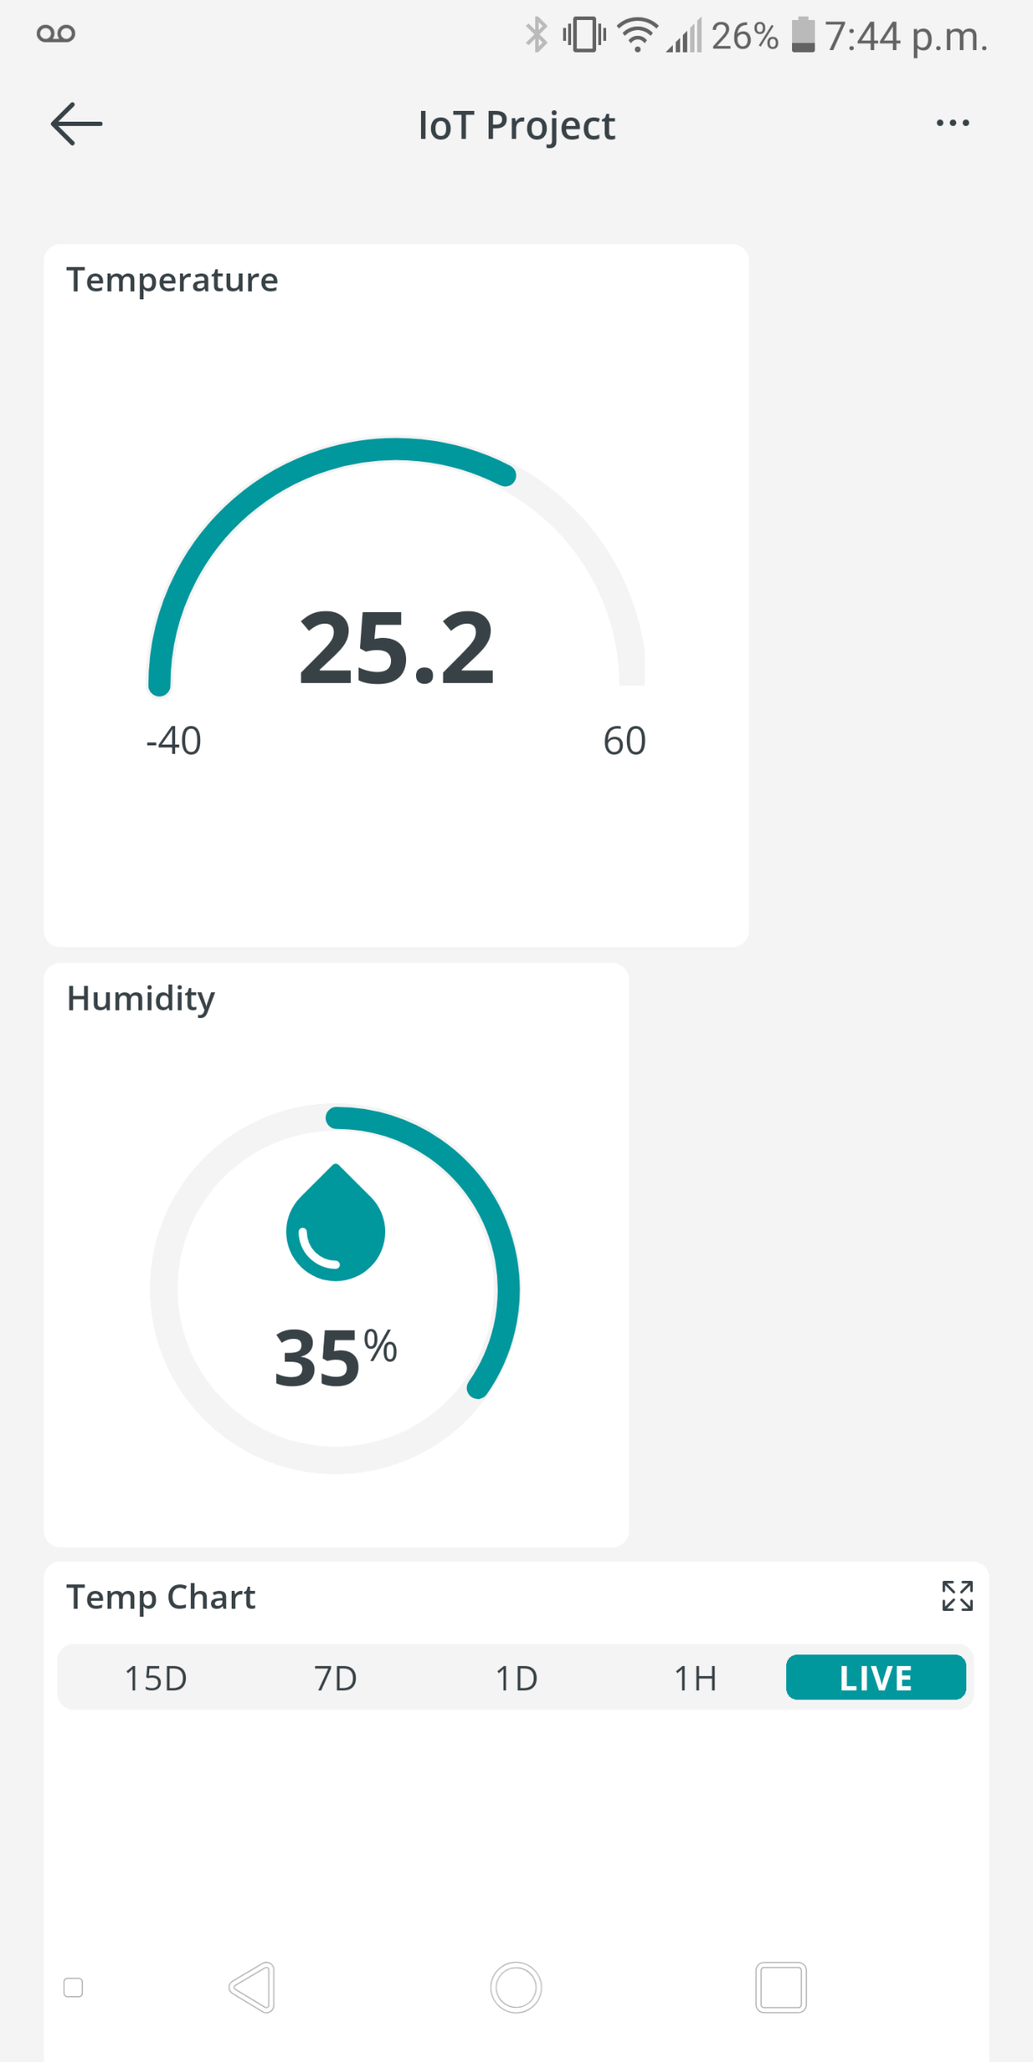
Dashboard
The final dashboard was a multi-platform output of our IoT sensor running on the cloud!

Slide 9
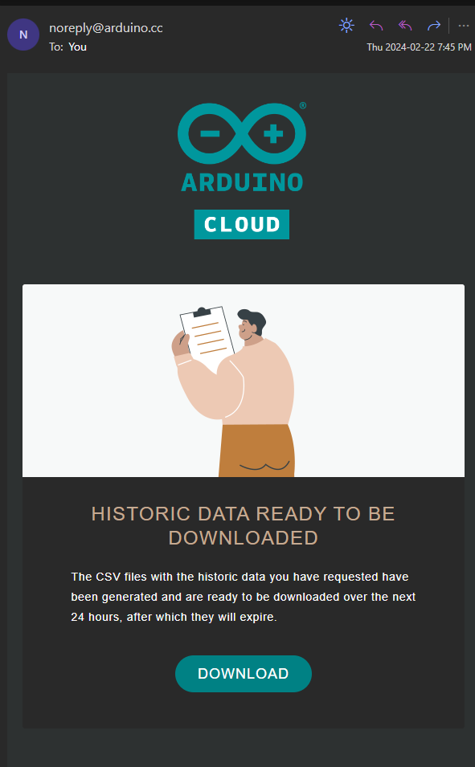
Data Export
After a few days of collecting data, we were able to export a CSV from the cloud to see what we have been gathering.

Slide 10
IoT in Industry

Slide 11
Security and Implementation

Slide 12
Next Steps for IoT

Slide 13
Regulations

Slide 14
Conclusions

Slide 15
References

Slide 16
Questions?

